Slide 1


DESIGN 1
Lesson 1: Build Sprint 3: Adding a Form
Ms. Abboud • Grade 9 - Design 1 • Term 1, Week 11

Slide 2
Learning Objectives
WALT - We Are Learning To
WILF - What I'm Looking For
Add a correctly labelled form that serves a real purpose on my website.
Clicking each label focuses its field.
My form makes sense for my audience.

Slide 3
Frayer Model: Form (Review)
DEFINITION
CHARACTERISTICS
The <form> tag: a container that groups input fields together so a website can collect information from a user.
The <form> tag; groups inputs together; used to collect data.
FORM
EXAMPLES
NON-EXAMPLES
A contact form.
A <table>; a paragraph asking a question with no inputs.

Slide 4
National Identity Integration
UAE Tourism Promotion: tourism websites use forms so visitors can ask a question, subscribe or plan a trip. Today you add the form your own visitors would actually use.

Slide 5
STARTER
What Form Would Your Visitors Fill In?
A contact form, a quiz, a sign-up, a vote?
Pick the one that fits your topic and your audience.
Hook • Engage & Ask
5 - 10 minutes

Slide 6
LESSON CORE
I Do: Recap the Form Tags
Remember Week 9: form, label with for, input with a matching id, input types, textarea, radio, checkbox, select and button.
The label's for and the input's id must match exactly.
Gradual Release of Responsibility
30 - 40 minutes
Example: a short form
<form>
<label for="name">Your name:</label>
<input type="text" id="name" name="name">
<label for="msg">Message:</label>
<textarea id="msg" name="msg"></textarea>
<button type="submit">Send</button>
</form>
1 / 3

Slide 7
LESSON CORE
We Do: Choose and Plan Your Form
Choose a form that fits your topic and audience.
On the planning sheet, write the label text, input type and id for each field before you code it.
Gradual Release of Responsibility
30 - 40 minutes
2 / 3

Slide 8
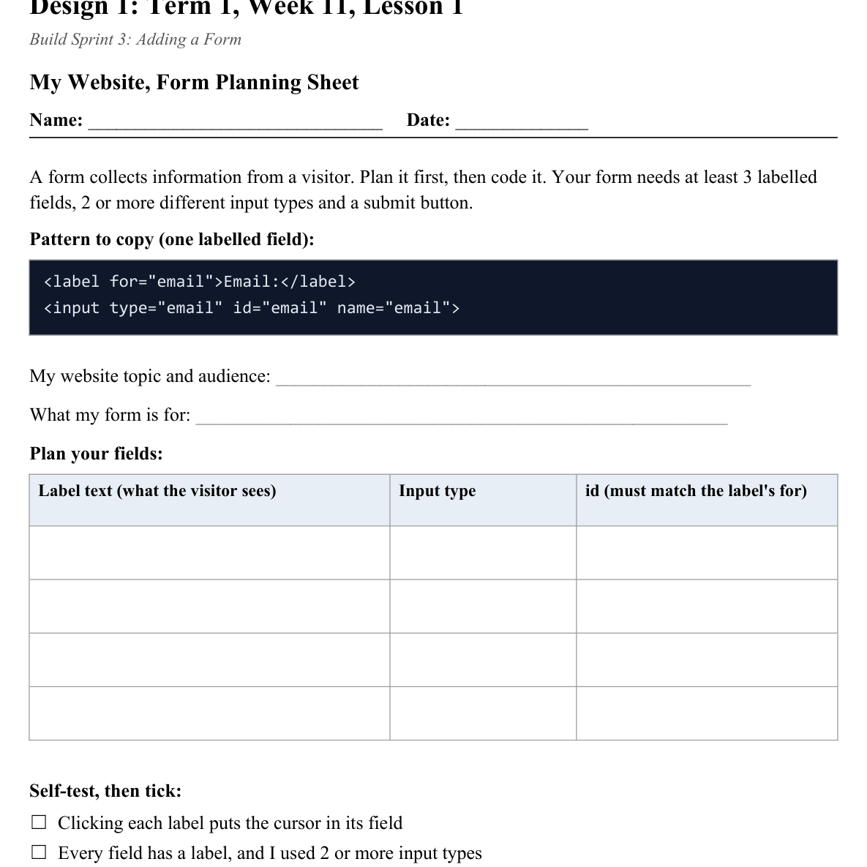
LESSON CORE
You Do: Build and Self-Test
Build a form with at least 3 labelled fields and 2 or more input types, plus a submit button.
Self-test: click every label, then try the form as a visitor.
Activity: My Website, Form Planning Sheet
Gradual Release of Responsibility
30 - 40 minutes
3 / 3

Slide 9
CLOSURE
Exit Ticket
Why does your website need this form?
Transition & Extend
5 - 10 minutes

